Slide 1
Recap
Primary goal
predict popularity of a song based on its audio features.
Secondary goal
predict the genre from its audio features.
Challenge
There are many genres, 114
Clean
Remove columns that are not needed:
Track_id
Artists
Album_name
Track_name
Remove rows without values
Explicit converted from ‘True’ and ‘False’ to ‘0’ and ‘1’

Slide 2
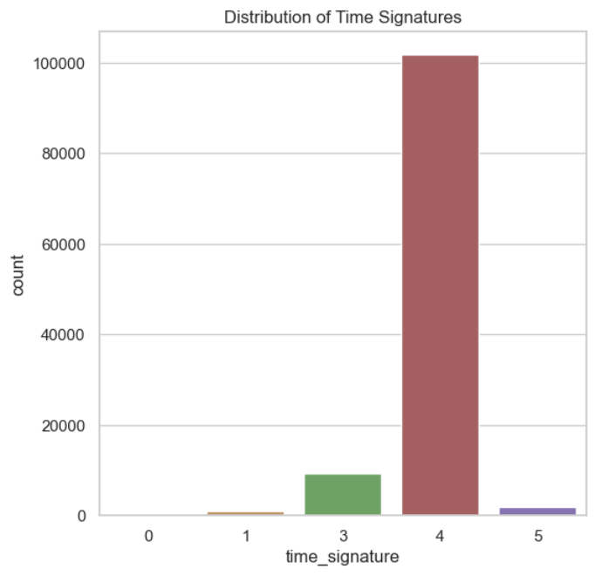
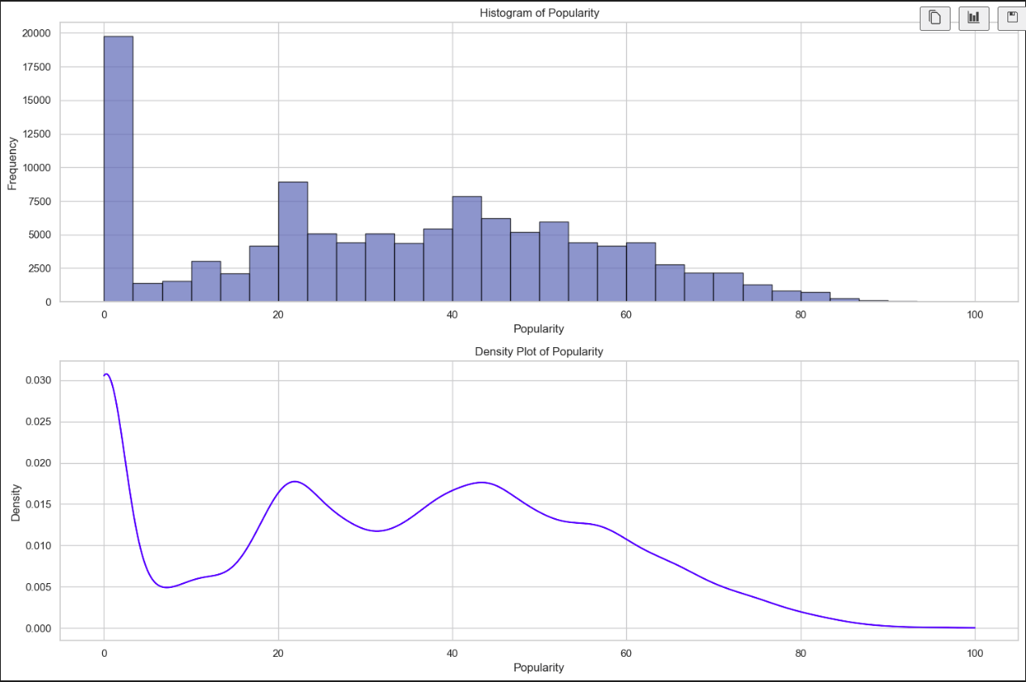
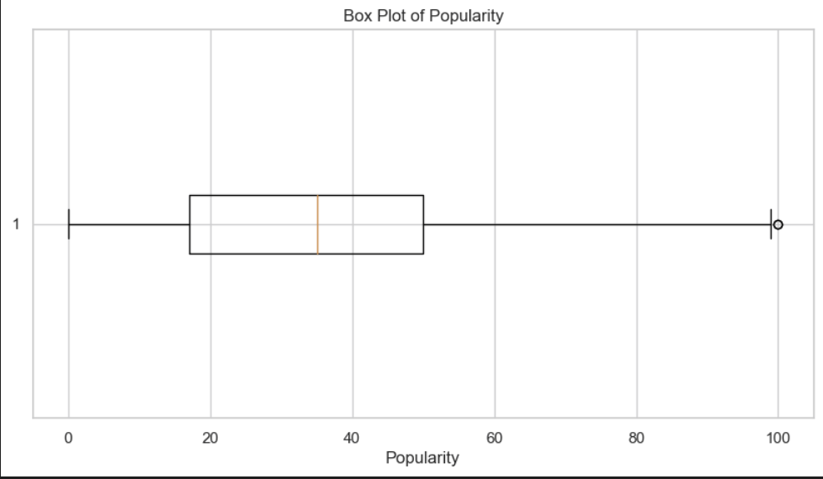
Visualizations - Distributions

Slide 3
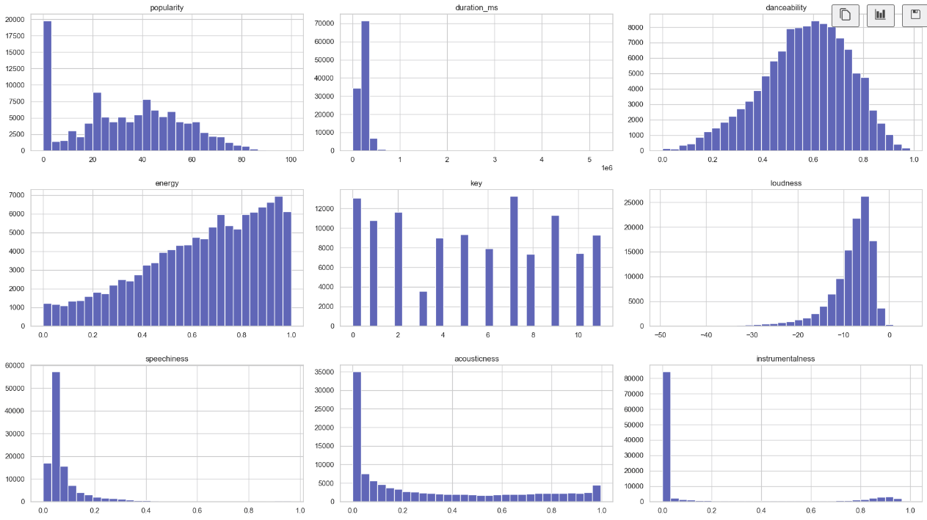

Slide 4
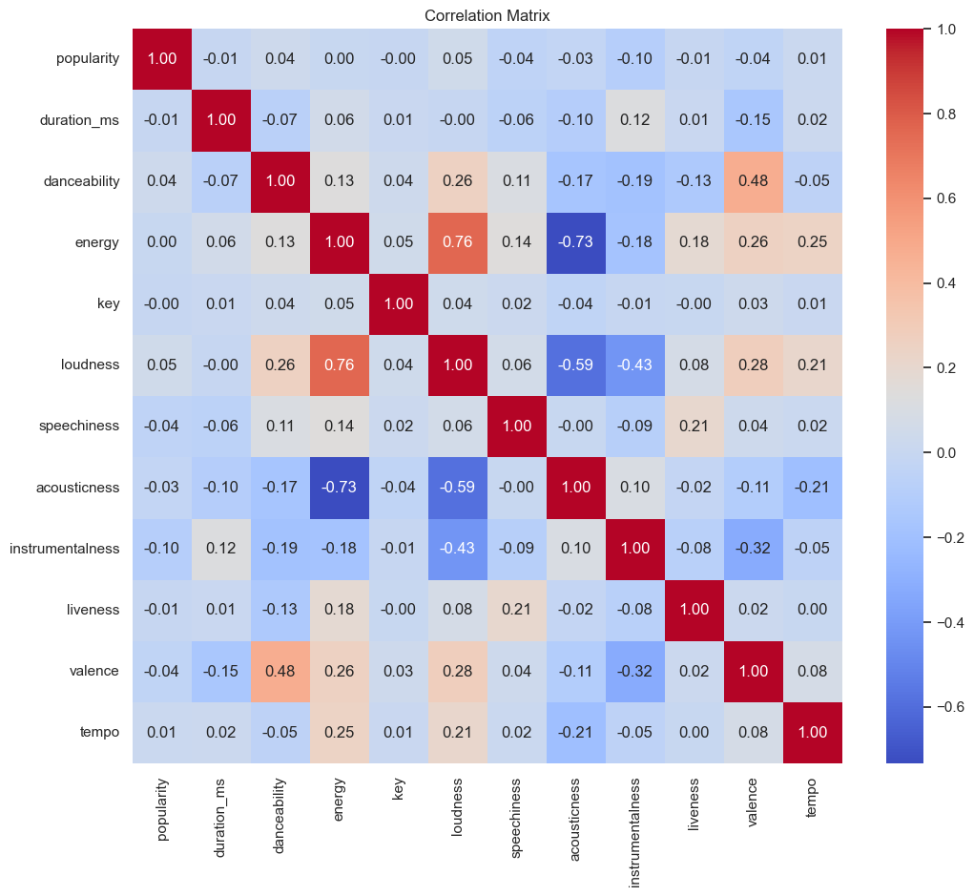
The matrix shows pairwise correlations between numerical features.
Note: most features have low correlations with each other.
Loudness and energy have a moderate positive correlations of 0.72.

Slide 5
